Slide 1
Management and valorisation of the digitised Belgian human remains collection
(Neandertal_3D)
SHAPE FITTING and APPROACHES TO MUSCLE WRAPPING OVER MULTIPLE SURFACES
Neandertal_3D follow up committee meeting, RBINS, 24 Apr 2018

Slide 2
WP 3 Methodological and IT development of (palaeo)anthropological tools - WPL: ULB
Task 3.2. Development and implementation of novel measurement tools in lhpFusionBox – TL: ULB
…automated modelling of joint and bone morphology using primitive objects (such as sphere, ellipse, quadric surfaces, etc.)
Task 3.4. Development of wrapping method – TL: ULB
A feasibility study on muscle wrapping was previously performed on the reconstructed Spy II skeleton and despite the fact that preliminary results were promising; it also demonstrated the limits of current methods and the need to develop more optimal musculoskeletal wrapping tools and models.

Slide 3
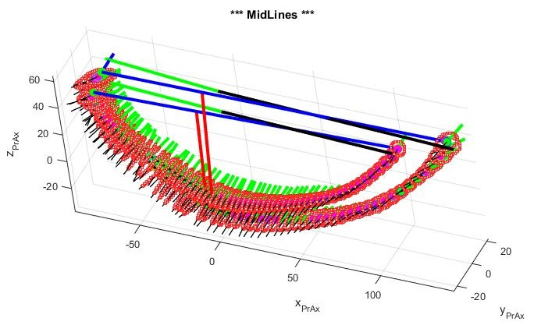
Task 3.2. Long bone fitting by ellipses and midline

Slide 4
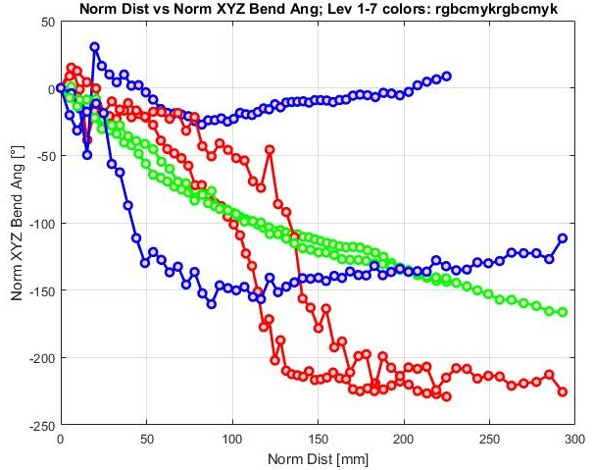
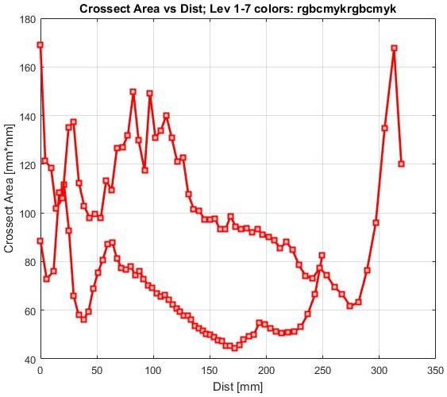
Task 3.2. Long bone fitting by ellipses and midline (some results)
Chapman, T., Beyer, B., Sholukha, V., Semal, P., Feipel, V., Louryan, S., Van Sint Jan, S., 2017a. How different are the Kebara 2 ribs to modern humans? J Anthropol Sci.

Slide 5
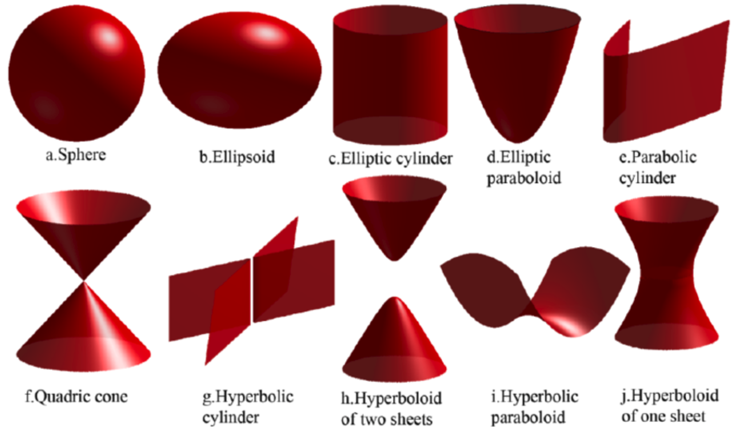
Task 3.2. Quadric surfaces

Slide 6
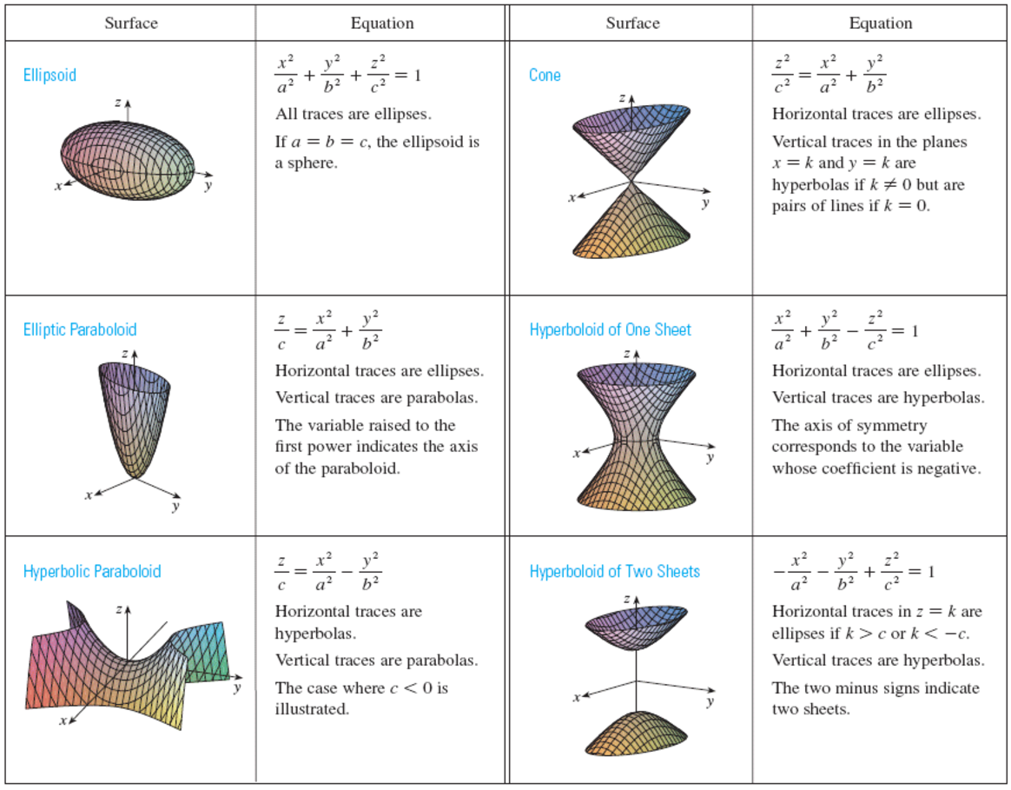

Slide 7
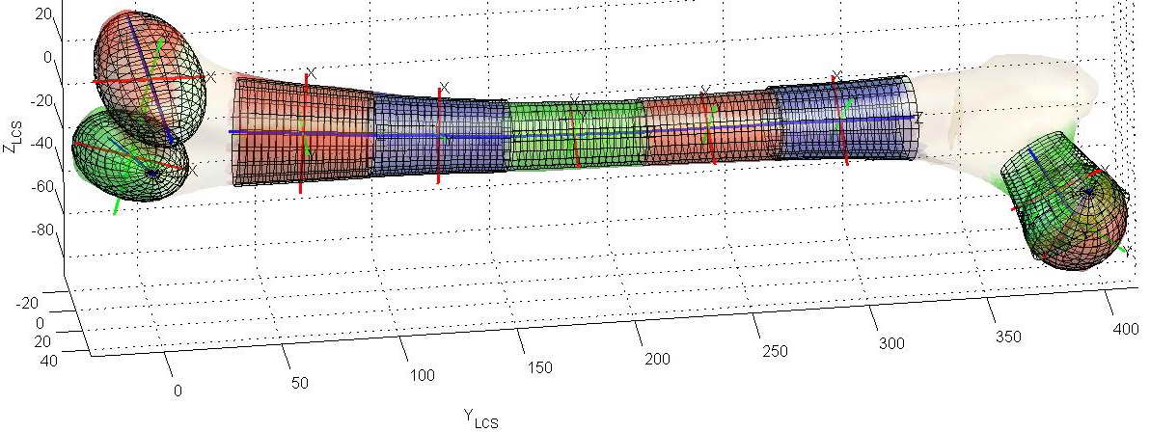
Task 3.2. Femoral bone quadric surfaces fitting
Sholukha, V., Chapman, T., Salvia, P., Moiseev, F., Euran, F., Rooze, M., Van Sint Jan, S., 2011. Femur shape prediction by multiple regression based on quadric surface fitting . J. Biomech. 44, 712–718.

Slide 8
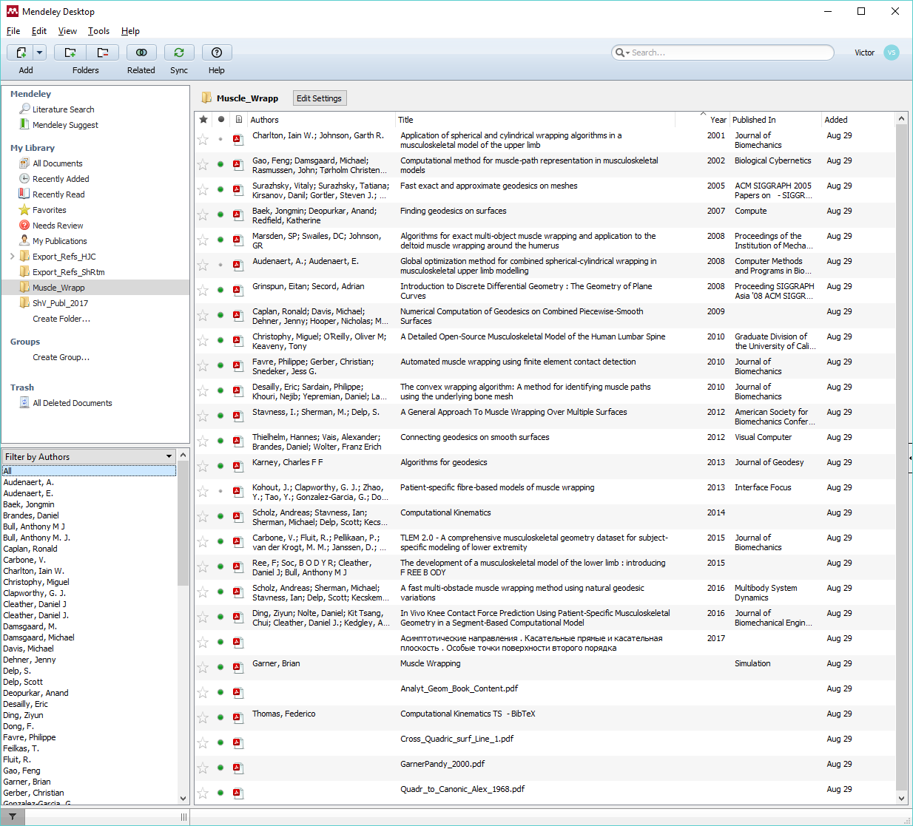
Task 3.4
Literature review
lhpFusionBox wrapping ref:
Audenaert, A., Audenaert, E., 2008. Global optimization method for combined spherical-cylindrical wrapping in musculoskeletal upper limb modelling. Comput. Methods Programs Biomed. 92, 8–19. doi:10.1016/j.cmpb.2008.05.005

Slide 9
Stavness I, Sherman M, Delp S. 2012. A general approach to muscle wrapping over multiple surfaces. In: Proceedings of the American Society of Biomechanics. Gainesville (FL); p. 1–2. Abstract 97.
Our formulation computes the minimum length wrapping path over multiple surfaces by finding the location of two wrapping points per surface such that joining paths are straight lines, wrapping paths are geodesic curves, and joining paths connect smoothly with wrapping paths (Figure 1).
Figure 1: The shortest path wrapping surfaces is represented with two wrapping points on each surface, straight joining paths (dotted lines), and geodesic wrapping paths (solid lines).

Slide 10
Figure 2: The local conditions that must be satisfied to find the shortest wrapping path. Wrapping points p and q must lie on the wrapping surface and straight-line joining paths vp and vq must be tangent to the surface. The geodesic curve originating from point p in the direction of vp (red line) and the geodesic curve originating from point q in the direction vq (blue line) must connect smoothly.

Slide 11
The wrapping conditions can be stated as follows:

Slide 12
For general smooth surfaces, we find geodesic curves using numerical integration.
For this purpose, we use the mechanical analogy that a particle moving along a surface with acceleration normal to the surface will trace a geodesic path [DeSapio et al., Multiby Syst Dyn, 19(3), 303–22, 2008].
For a particle r, we solve the differential equation
(1)
Final system of ODE:
(2)
(3)
Baumgarte stabilization parameters β, α

Slide 13
Multiple collision detection and reaction (wrapping).
(4)
(5)
A.Scholz. (2015 ) Fast Differential-Geometric Methods for Continuous Muscle Wrapping Over Multiple General Surfaces, PhD

Slide 14
Alternative Approach for Geodesics Evolution:
Numerical Computation of Geodesics on Combined Piecewise-Smooth Surfaces
Ronald Caplan, Michael Davis, Jenny Dehner, Nicholas Hooper and Heather Mattie
Advisor: Ali Nadim, Claremont Graduate University
Liaison: Thomas Grandine, The Boeing Company
June 4, 2009
Tangential to the curve
Curvature
Surface normal
From the previous steps, calculate the geodesic curvature kg(s) at every point. The vector is defined as follows: at a point s on a curve γ, the geodesic curvature kg(s) is the curvature vector k of the curve γ projected onto the tangent plane of the surface at s. We see this from the following equation (1):
(1)

Slide 15
From basic differential geometry, we know that the geodesic occurs when kg (s) = 0 for all points on a curve.
(2)
Geodesic evolution from ODE:
(3)
where

Slide 16
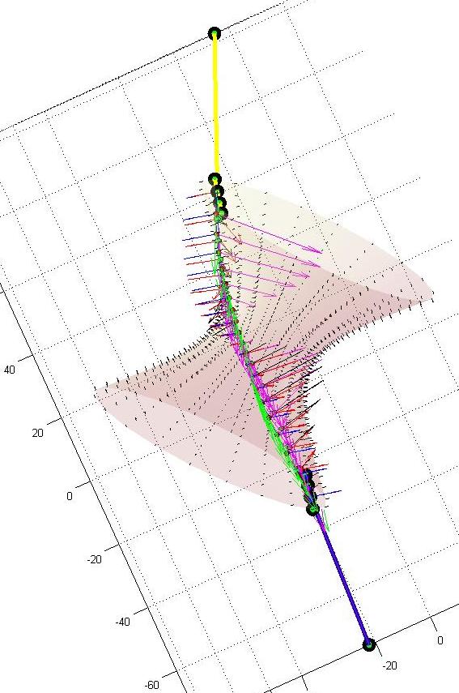
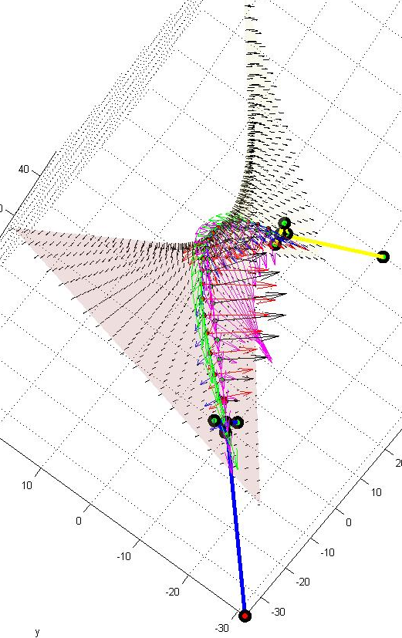
Examples of geodesic line evaluated from zeroing the geodesic curvature
Hyperboloid of one sheet
Hyperbolic paraboloid

Slide 17
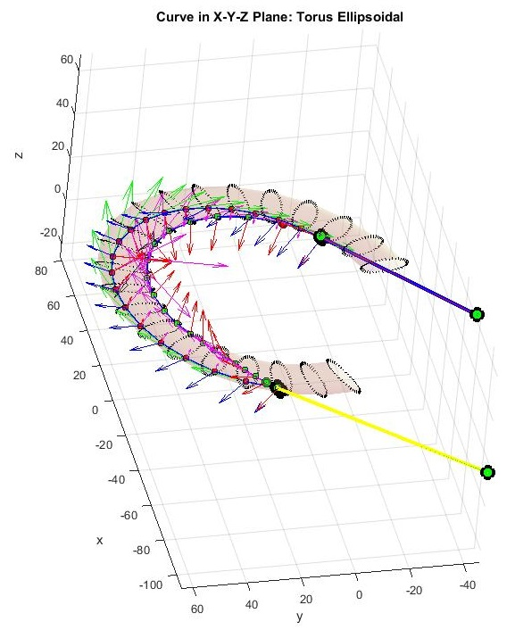
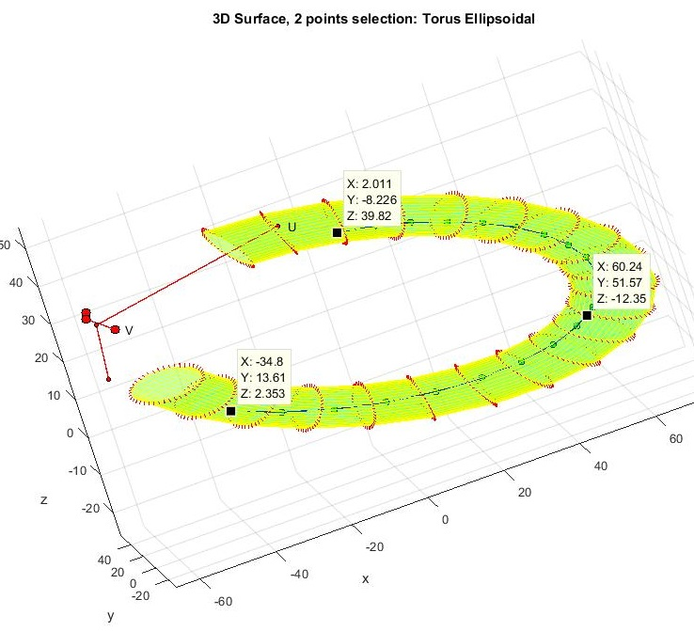
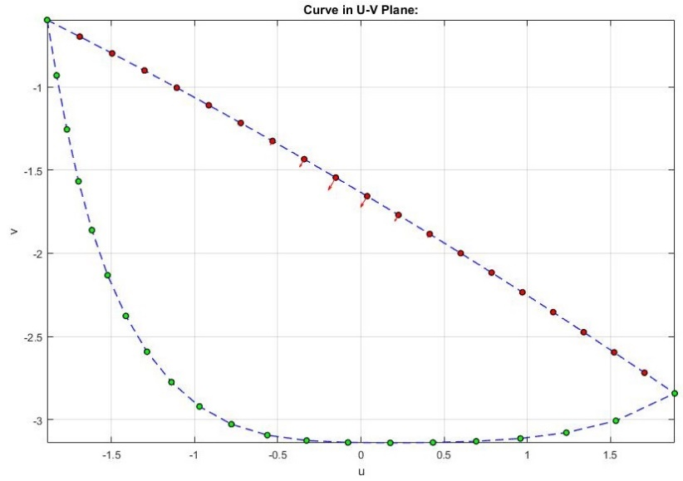
Example of geodesic line evaluated (Torus Ellipsoidal)

Slide 18
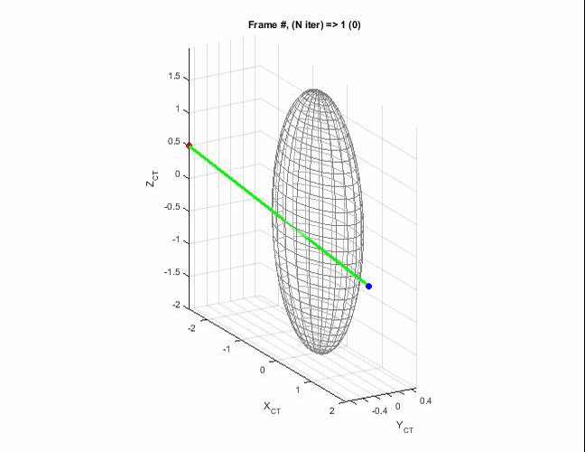
Muscle path multibody wrapping and multiple collision (some results)
Collision_L_123Bd_ShV_5fps.avi

Slide 19
Thanks for your
attention

Slide 20
