Slide 1
NEANDERTAL 3D New functionalities in lhp fusionbox
Follow up committee meeting of Neandertal_3D
Panagiotis Gonidakis
Bart Jansen

Slide 2
New functionalities in lhp fusionbox
Contents
Import a Wavefront .OBJ file
Display texture
Generate measurements between landmarks

Slide 3
New file format
obj
OBJ is a geometry definition file format
Represents 3D geometry:
The position of each vertex
The UV position of each texture coordinate vertex
Vertex normal
The faces that make each polygon defined as a list of vertices
The texture vertices
File -> Import -> Geometries -> OBJ

Slide 4
New file format
obj

Slide 5
texture
background
Texture Mapping
The process of applying an image to the polygons
Improve visual realism
Using OpenGL
We still manually configure the texture units of our graphics hardware
Texture Data
Generally textures are stored as bitmaps
A big linear chunk of memory containing the red, green, blue (and alpha)
Compressed file formats like JPEG or PNG must be decompressed

Slide 6
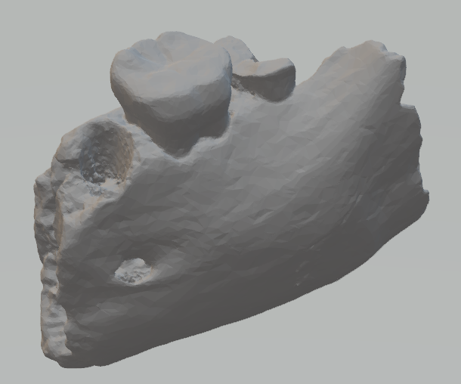
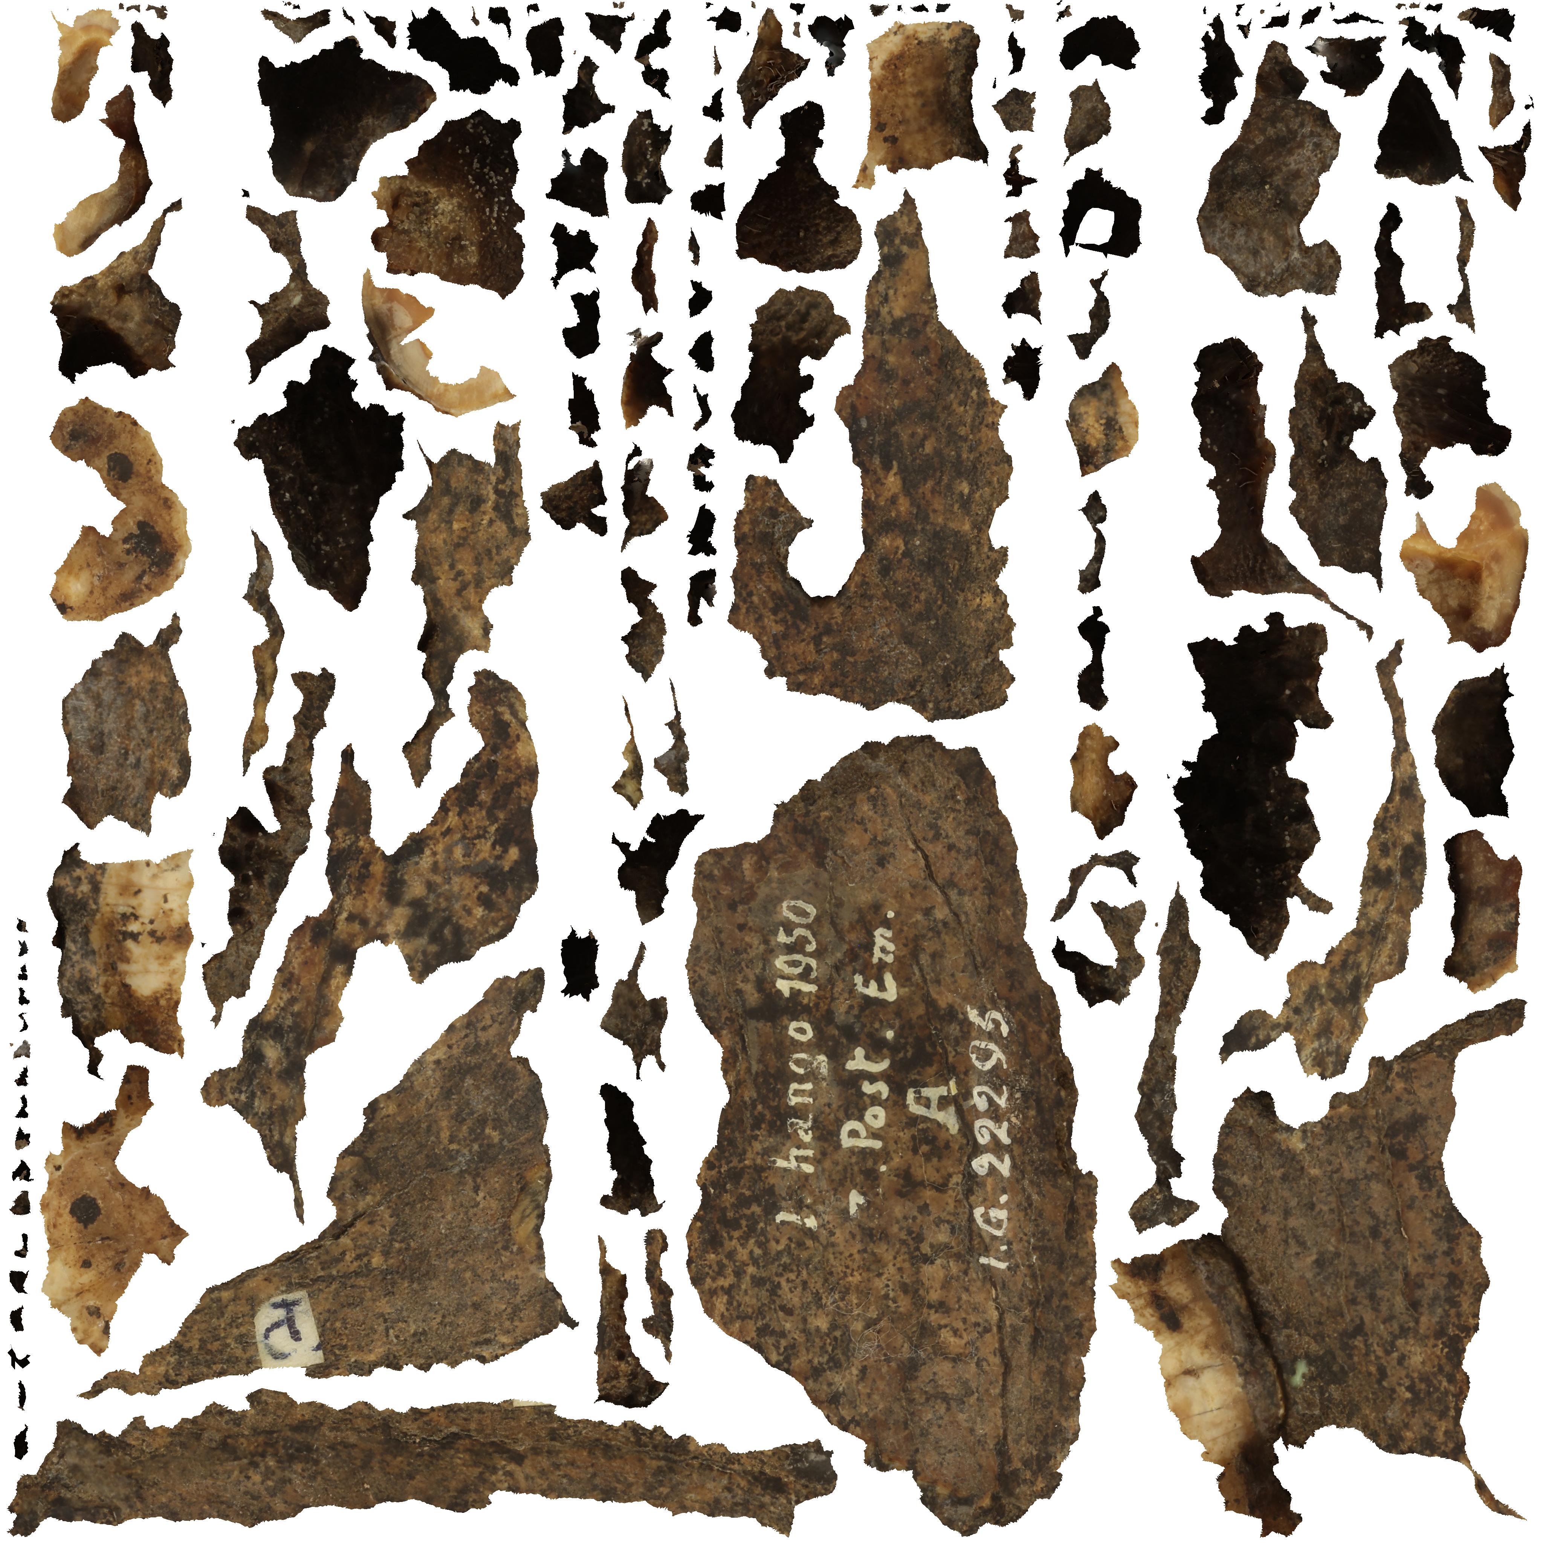
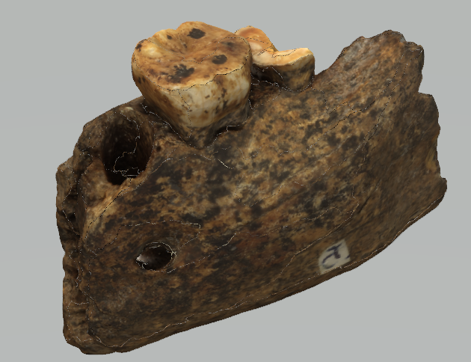
Display texture
The OBJ file
The PNG file
Use case
Import an .OBJ file
Import a .PNG file
Create Textured Surface
Map texture with the image file
Optionally, use a .mtl file (lighting, colors)

Slide 7
Display texture
Import obj, png
Import an .OBJ file
File -> Import -> Geometries -> OBJ
Import a .PNG file
File -> Import -> Images -> Images
Create Textured Surface
View -> Add View -> Textured Surface
Map texture with the image file
Select VME, VME GUI -> Texture, Select image from Window, OK
Optionally, use a .mtl file (lighting, colors)

Slide 8
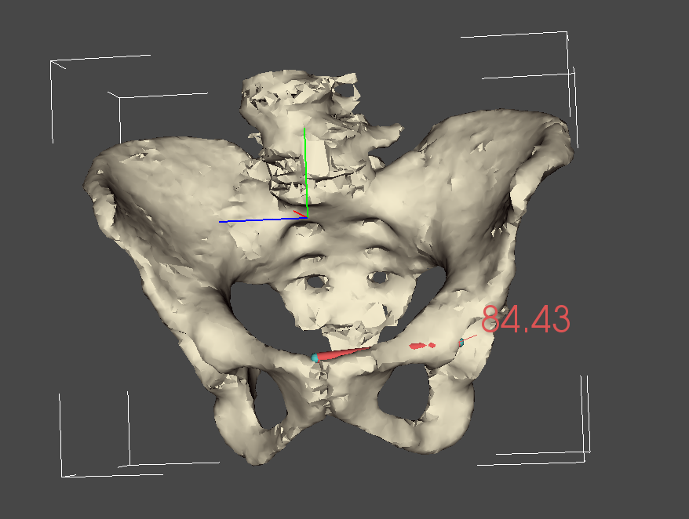
Generate meters
Use case
Bone: R_Pelvis_183_
Landmark Cloud: Pelvis ALS
Landmarks:
PUM
PUM1
Meter:
Point distance

Slide 9
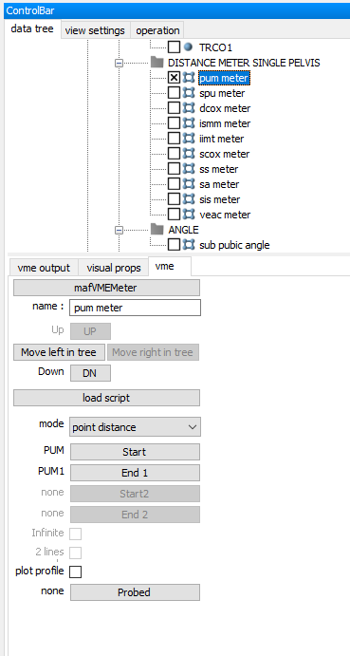
Generate meters
manually
Select the Point Cloud
Create Meter
Select Meter from Hierarchy
Edit:
Start: PUM
End 1: PUM1
Mode: point distance
The same process has to be done for all the measurements (takes a long time…)

Slide 10
Generate meters
manually
Select the Point Cloud
Create Meter
Operations -> Create -> Derive -> Meter
Select Meter from Hierarchy
Edit:
Start: PUM
End 1: PUM1
Mode: point distance

Slide 11
Generate meters
Dictionary to measure the point
Distance between PUM and PUM1
Scripted meters
Create a text document .dic
Measurements
Point distance: Landmark1 Landmark2 pd
Line angle: Landmark1 Landmark2 Landmark3 la
In a single .dic we can have more than one meter
Dictionary to measure the angle
between SPU, SPU1 and PUM1

Slide 12
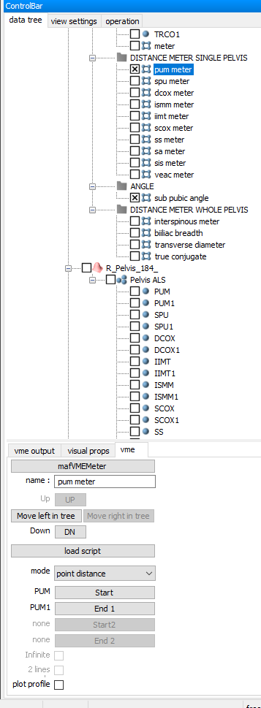
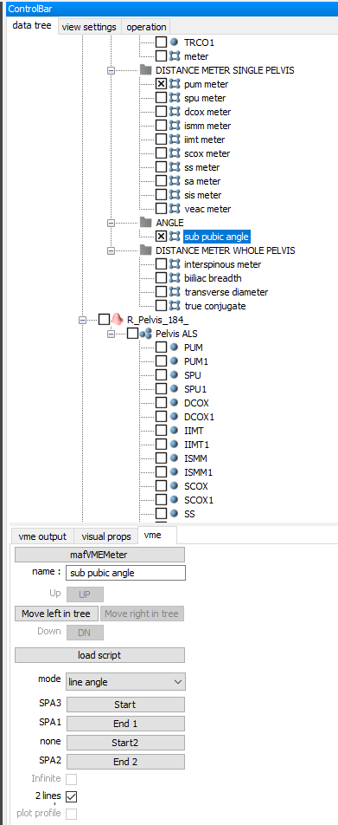
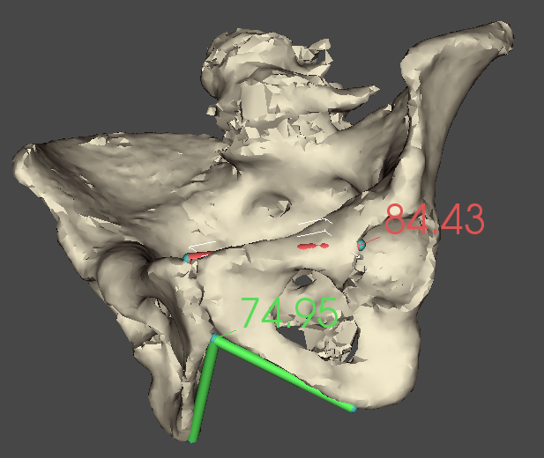
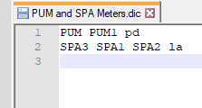
Generate meters
Scripted meters
Create a text document .dic
Measurements
Point distance: PUM PUM1 pd
Line angle: SPU SPU1 PUM1 la

Slide 13
Generate meters
Scripted meters
Create a .dic file (Done)
Select the point cloud in hierarchy
Otherwise it is disabled
Avoid conflicts between cloud points
Create a scripted meter
Operation -> Create -> New -> scripted meter
Load .dic file

Slide 14
New Functionalities in LhpFusionBox
Future work
Extend scripted meters to measure an angle by defining 4 landmarks.
Find a standard format / method to export 3D textured model.
Already working on muscle wrapping.
Receive feedback / Recommendations?
Method…
User Interface…
Visualization…
Future Tasks

Slide 15
Thank you!
Questions?

