Slide 1
lhpFusionBox
1995
1996
1997
1998
1999
2000
2001
2002
2003
2004
2005
2006
2007
2008
2009
2010
2011
2012
2013
2014
2015
2016
2017
2018
History, heritage and links with Neanderthal3D

Slide 2
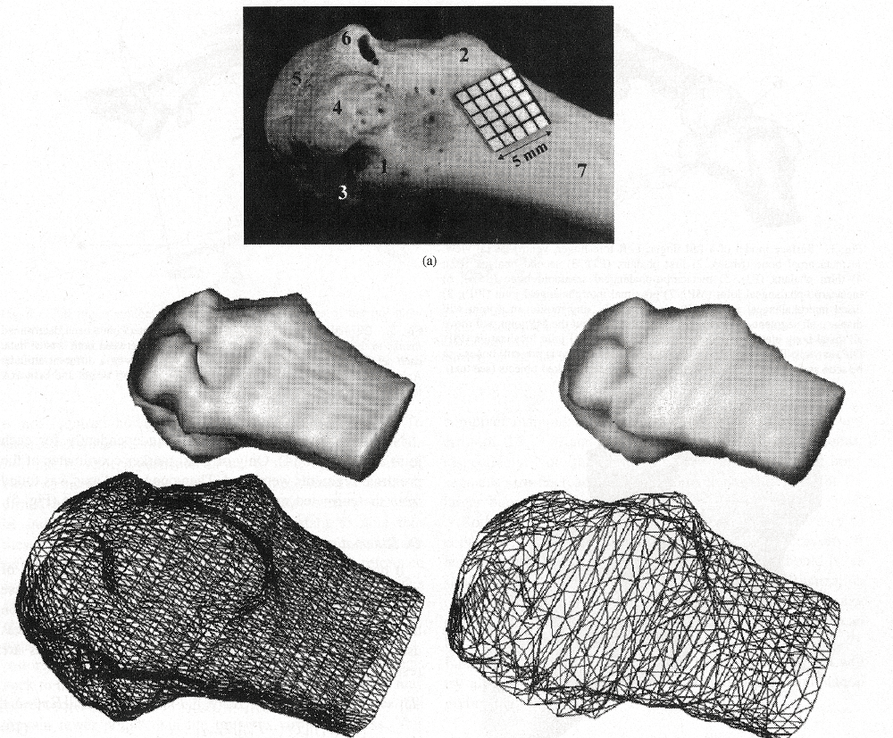
1995
1996
1997
1998
1999
2000
2001
2002
2003
2004
2005
2006
2007
2008
2009
2010
2011
2012
2013
2014
2015
2016
2017
2018

Slide 3
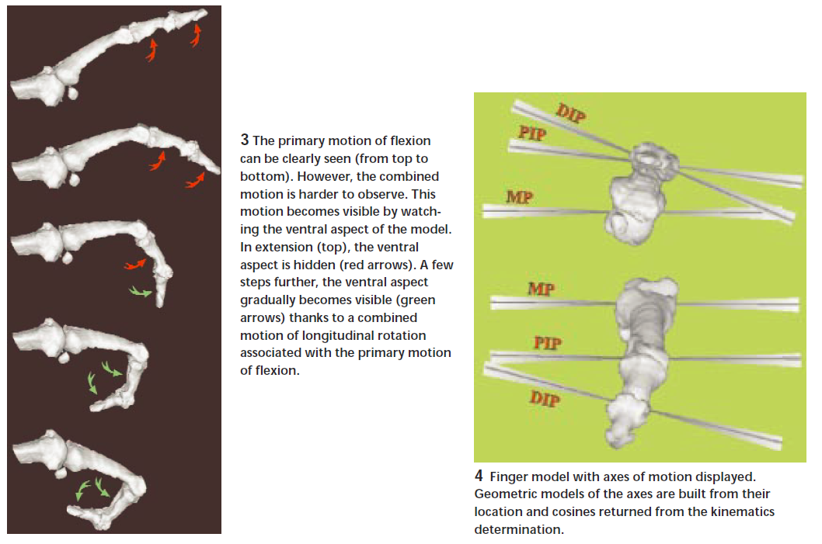
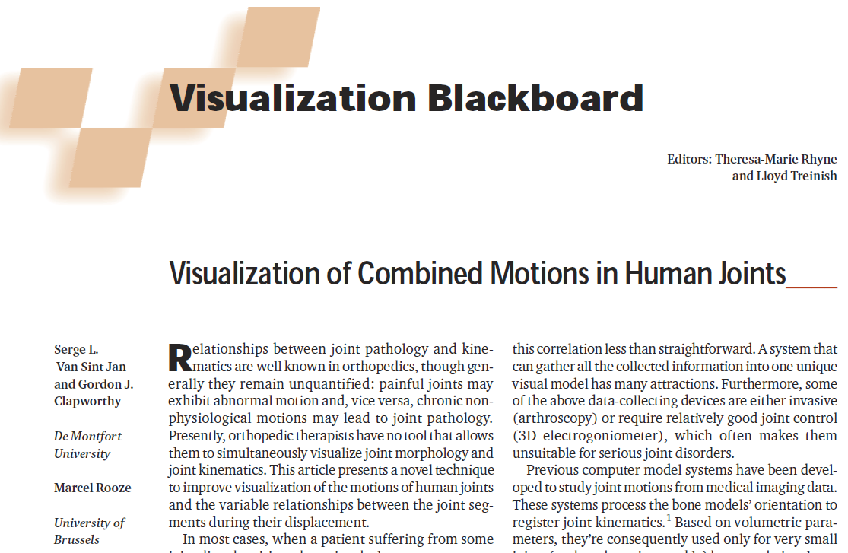
1995
1996
1997
1998
1999
2000
2001
2002
2003
2004
2005
2006
2007
2008
2009
2010
2011
2012
2013
2014
2015
2016
2017
2018

Slide 4
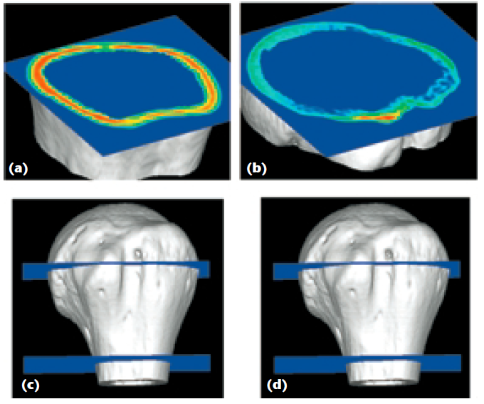
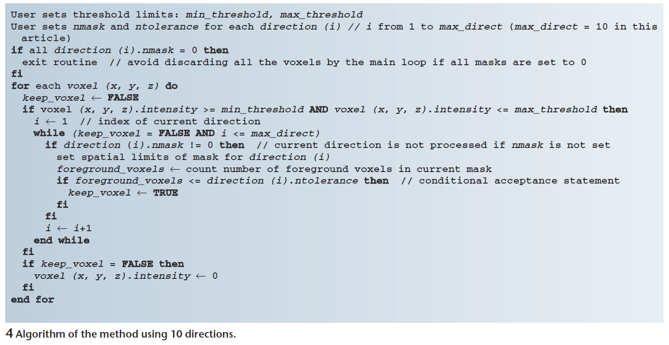
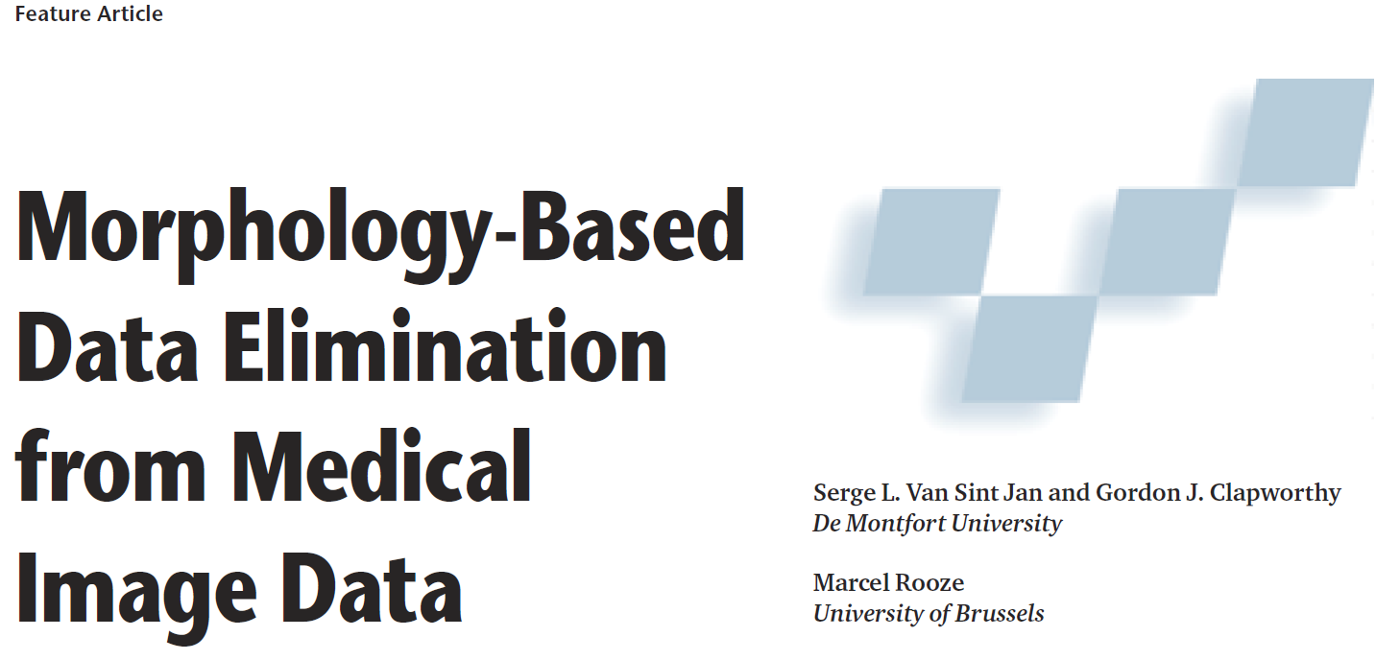
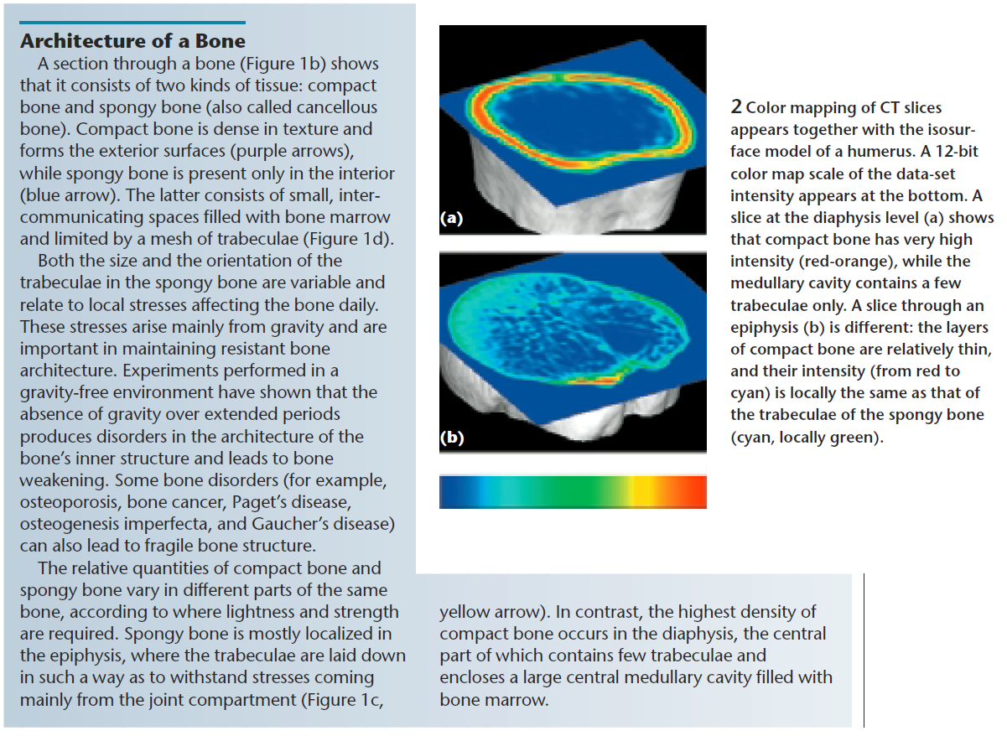
1995
1996
1997
1998
1999
2000
2001
2002
2003
2004
2005
2006
2007
2008
2009
2010
2011
2012
2013
2014
2015
2016
2017
2018

Slide 5
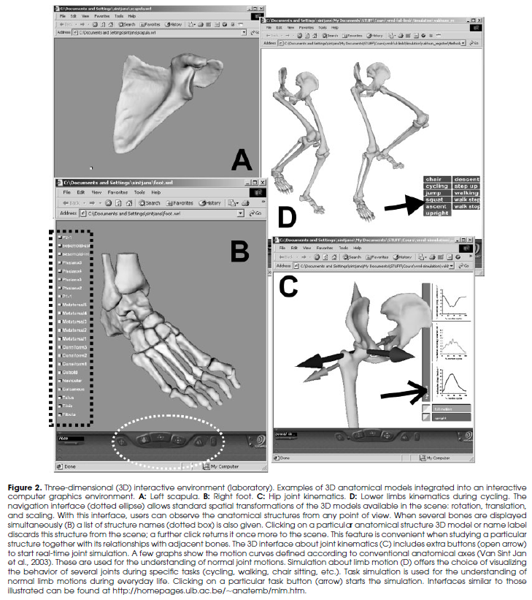
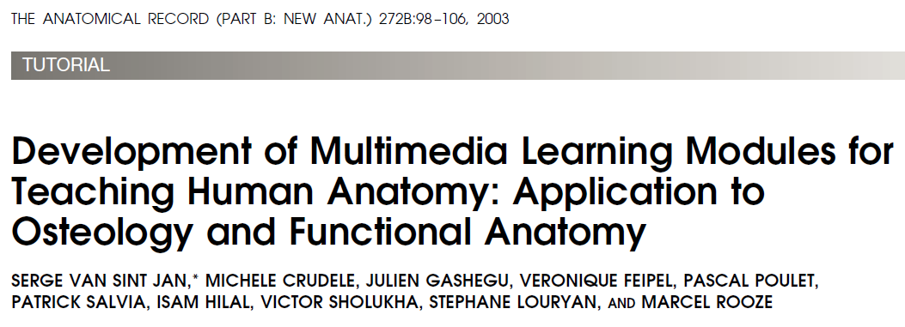
1995
1996
1997
1998
1999
2000
2001
2002
2003
2004
2005
2006
2007
2008
2009
2010
2011
2012
2013
2014
2015
2016
2017
2018
VAKHUM Project (2000-2002)

Slide 6
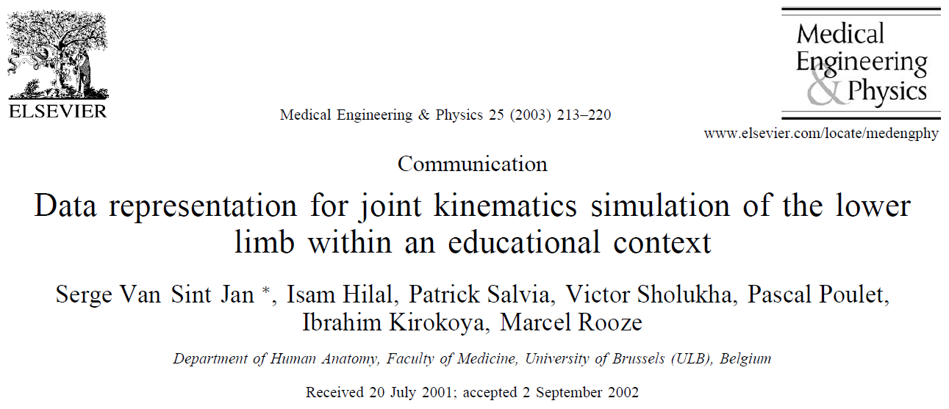
1995
1996
1997
1998
1999
2000
2001
2002
2003
2004
2005
2006
2007
2008
2009
2010
2011
2012
2013
2014
2015
2016
2017
2018
VAKHUM Project (2000-2002)

Slide 7
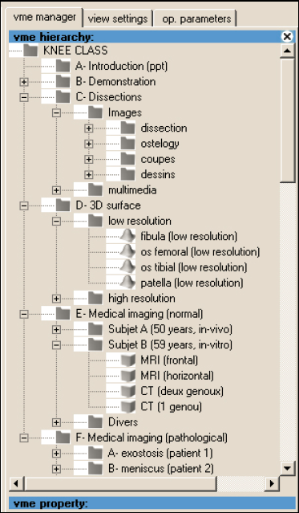
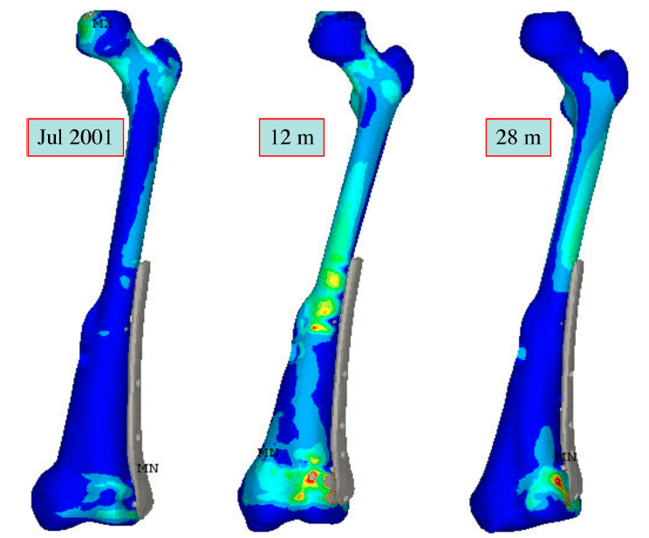
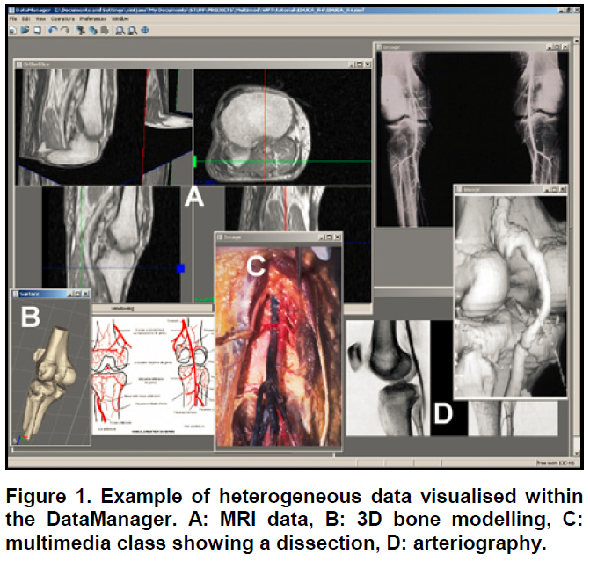
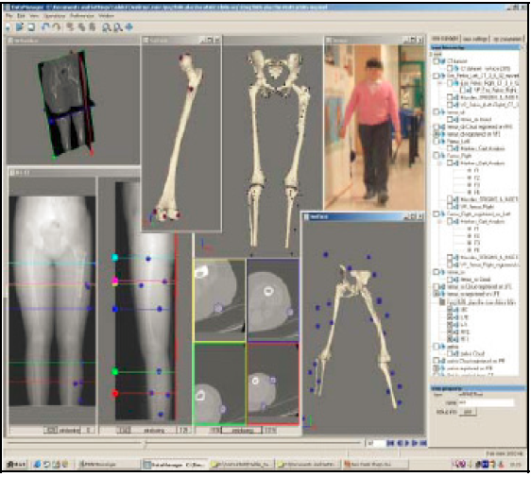
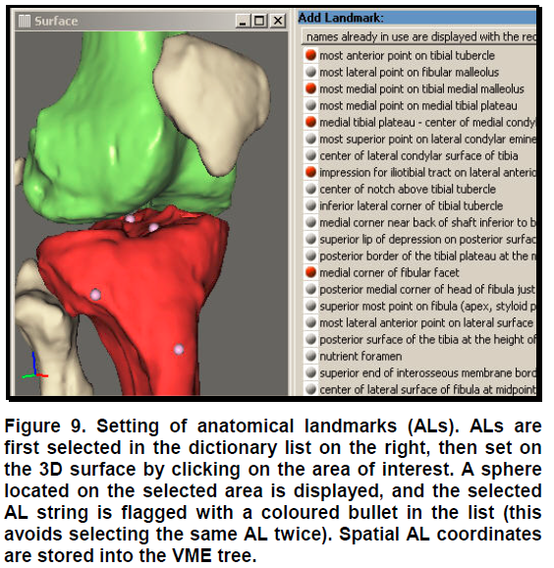
MAF = Multimod Application Framework
1995
1996
1997
1998
1999
2000
2001
2002
2003
2004
2005
2006
2007
2008
2009
2010
2011
2012
2013
2014
2015
2016
2017
2018
LHDL Project
(2006-2009)
VPH-NoE Project
(2008-2012)
MULTIMOD Project (2001-2004)

Slide 8
The lhpFusionBox
1995
1996
1997
1998
1999
2000
2001
2002
2003
2004
2005
2006
2007
2008
2009
2010
2011
2012
2013
2014
2015
2016
2017
2018

Slide 9
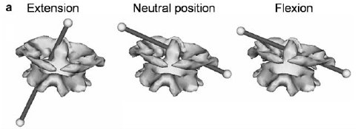
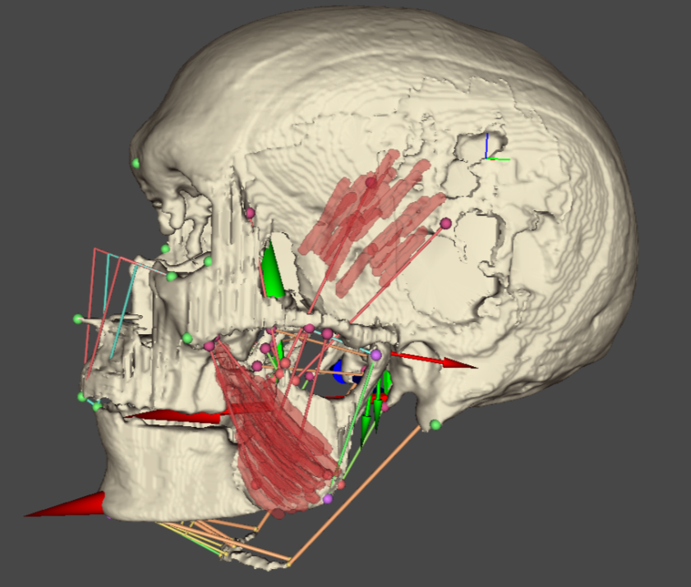
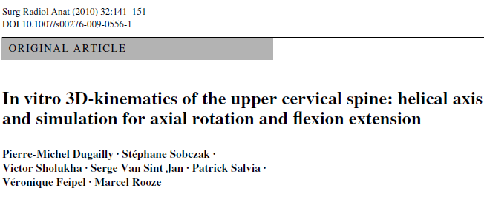
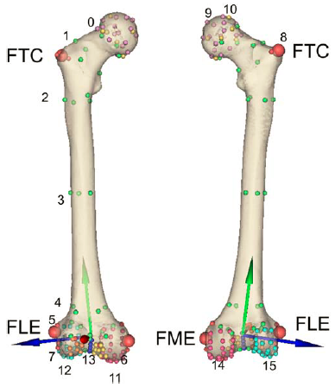
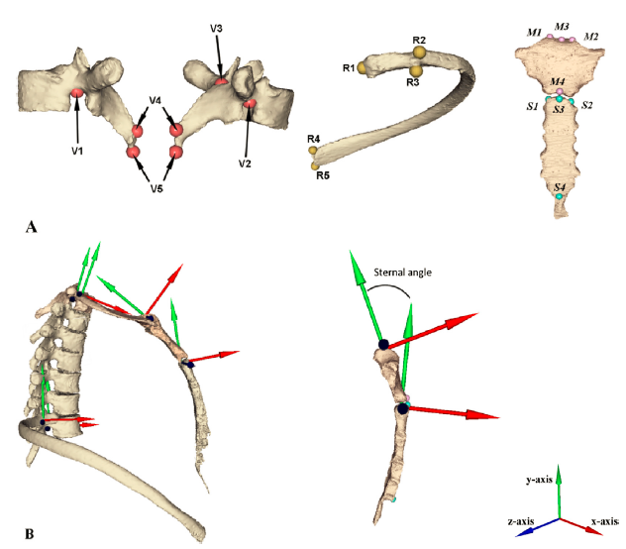
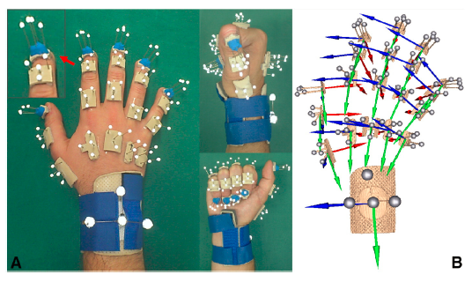
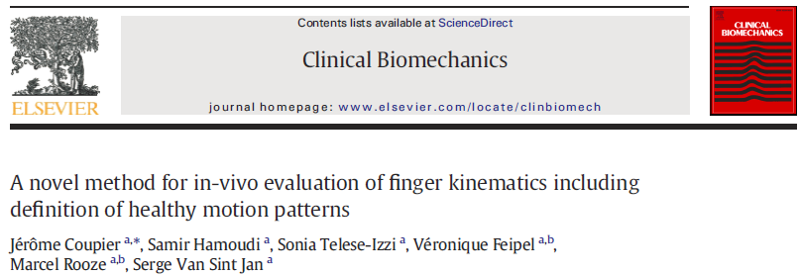
The lhpFusionBox
1995
1996
1997
1998
1999
2000
2001
2002
2003
2004
2005
2006
2007
2008
2009
2010
2011
2012
2013
2014
2015
2016
2017
2018

Slide 10
Neanderthal3D
1995
1996
1997
1998
1999
2000
2001
2002
2003
2004
2005
2006
2007
2008
2009
2010
2011
2012
2013
2014
2015
2016
2017
2018
MAF = Multimod Application Framework
Airs of MAF and FusionBox heritage
Project aims:
To adapt MAF and FusionBox to Anthropology needs
Requested to inform original founders
The lhpFusionBox

