Slide 1






Neandertal_3D Project
Management and valorisation of the digitised Belgian human remains collection
By Tara Chapman
RBINS
Notes:
1
Hello
My name is Tara Chapman. My phd is on
1

Slide 2
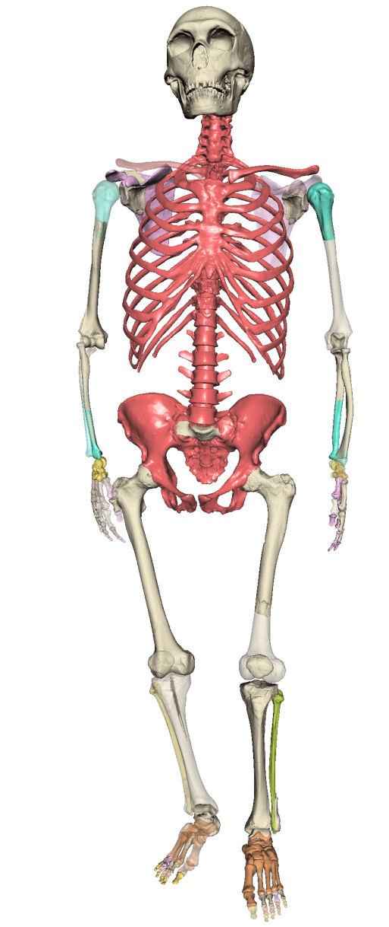
Neandertal_3D – BRAIN project
BRAIN projects are to stimulate effective collaborations in research by FSI’s and the rest of the scientific community (currently 33)
Axis 3: Cultural, historical and scientific heritage
Management and valorisation of the digitised Belgian human remains collection
Neandertal_3D project runs from June 01 2017 – May 31 2019 (2 years)
Budget : 599,426 EUR
Notes:
This project aims to utilise the existing digital collection of Neandertal and AMH fossils which are housed at the Royal Belgian Institute of Natural Sciences and to showcase the reconstructed Spy skeleton to highlight Belgian scientific and cultural heritage as well the current state of the art research in Belgium. There are four aspects to the project:
1) improvement of existing 'lhpFusionBox' software to make this programme fully adapted to the needs of paleoanthropologists,
2)the creation of a serious game using the reconstructed Spy II skeleton and body,
3)to prepare the reconstructed 3D Spy II Neandertal and other Neandertal fossil specimens for 3D printing and then place these fossils online and freely available
4) to create an interactive website which will serve as an educational experience on Neandertals, who are often portrayed in the public as cavemen, stupid brutish and more ape like than modern humans.
FSIs - acquires, conserves, restores, manages and valorises collections as well as archives which are composed – or relate to – material and immaterial cultural and scientific heritage, of an origin and scope that is either national or international. Through its expertise, it also contributes to the valorisation of non-federal heritage.
2

Slide 3
Project Partners and subcontractors
LABO, Université Libre de Bruxelles (ULB) (Co-ordinator)
Royal Belgian Institute of Natural Sciences (RBINS)
ETRO, Vrije Universiteit Brussel (VUB)
Association pour la Diffusion de l’Information Archéologique (ADIA) (Subcontractor)
Musée de l’Homme (MHNH) (International Partner)
Notes:
First specimen was Neandertal 1. 400 more specimens have been found.
The full suite of Neandertal features appears with classic Neandertals which existed between 70,000 – 30,000 years ago. Neandertal features are heavy brows – long low skulls, more importantly robustness of bones wide pelvis
The tools they used was part of the Mousterian industry. The Mousterian industry was use of Levallois and discoidal flaking techniques for the production of flakes that could be converted to a wide rangee of shapes. Side-scrapers, nothces and small handflakes. Levallois technique is a distinctive method of stone tool production used during Middle Paleolithic in which flakes were removed from flint cores.
Neanderthal sites have lots of fauna indicating a high reliance of meat in their diet. Large palaeartic mammals are most commonly found in these assemblages bison, wild cattle, horse, reindeer. Isotopic analysis shows a strong reliance on herbivore meat. Also a reliance on wholly rinocerus and wholly mammoth. No-one knows how much is by hunting or scavenging.

Slide 4
Different aspects of the project
There are four aspects to the project:
1) improvement of existing 'lhpFusionBox' software
2)creation of a serious game using reconstructed Spy II skeleton
3) prepare the reconstructed 3D Spy II Neandertal and other Neandertal fossil specimens for 3D printing
4) to create an interactive website which will serve as an educational experience on Neandertals
Notes:
This project aims to utilise the existing digital collection of Neandertal and AMH fossils which are housed at the Royal Belgian Institute of Natural Sciences and to showcase the reconstructed Spy skeleton to highlight Belgian scientific and cultural heritage as well the current state of the art research in Belgium. There are four aspects to the project:
1) improvement of existing 'lhpFusionBox' software to make this programme fully adapted to the needs of paleoanthropologists,
2)the creation of a serious game using the reconstructed Spy II skeleton and body,
3)to prepare the reconstructed 3D Spy II Neandertal and other Neandertal fossil specimens for 3D printing and then place these fossils online and freely available
4) to create an interactive website which will serve as an educational experience on Neandertals, who are often portrayed in the public as cavemen, stupid brutish and more ape like than modern humans.
4

Slide 5
Workpackages
WP1 Project Management
WP2 Reviewing and Analysis Package: lhpFusionBox software
WP3 Methodological and IT development of Paleoanthropological tools
WP4 Non contract reproduction of cultural heritage objects
WP5 Creation of multilingual website based on Neandertals
WP6 Creation of a Neandertal avatar based game
WP7 Dissemination and vulgarisation
Notes:
This project aims to utilise the existing digital collection of Neandertal and AMH fossils which are housed at the Royal Belgian Institute of Natural Sciences and to showcase the reconstructed Spy skeleton to highlight Belgian scientific and cultural heritage as well the current state of the art research in Belgium. There are four aspects to the project:
1) improvement of existing 'lhpFusionBox' software to make this programme fully adapted to the needs of paleoanthropologists,
2)the creation of a serious game using the reconstructed Spy II skeleton and body,
3)to prepare the reconstructed 3D Spy II Neandertal and other Neandertal fossil specimens for 3D printing and then place these fossils online and freely available
4) to create an interactive website which will serve as an educational experience on Neandertals, who are often portrayed in the public as cavemen, stupid brutish and more ape like than modern humans.
5

Slide 6
WP1 Project Management
This focus of this workpackage is the overall management of the project.
  Task 1.1 Project Coordination (ULB)
  Task 1.2. Project Reporting (RBINS)
The creation of the website of the project on the RBINS Scientific Service Heritage Plone server has been set up. All members of the project have access to the server with a unique user name and password. The members of the follow up committee also have access to the project website.
http://collections.naturalsciences.be/ssh-projects/projects/neanderthal-3d
User name: fcneandertal3D
Password: Neanderthal3D$
Notes:
This project aims to utilise the existing digital collection of Neandertal and AMH fossils which are housed at the Royal Belgian Institute of Natural Sciences and to showcase the reconstructed Spy skeleton to highlight Belgian scientific and cultural heritage as well the current state of the art research in Belgium. There are four aspects to the project:
1) improvement of existing 'lhpFusionBox' software to make this programme fully adapted to the needs of paleoanthropologists,
2)the creation of a serious game using the reconstructed Spy II skeleton and body,
3)to prepare the reconstructed 3D Spy II Neandertal and other Neandertal fossil specimens for 3D printing and then place these fossils online and freely available
4) to create an interactive website which will serve as an educational experience on Neandertals, who are often portrayed in the public as cavemen, stupid brutish and more ape like than modern humans.
6

Slide 7
WP2 Reviewing and Analysis Package: lhpFusionBox software
This focus of this workpackage was a review of the current literature on measurements, analysis and visualisation tools and the identification of the tools necessary for effective palaeoanthropological study.
  Task 2.1: Review of the literature (RBINS, 1-6 mths)
  Task 2.2 Definition of User Specification (RBINS, 1-6 mths)
  Task 2.3. Definition of Technical Specification (VUB, 1-6mths)
Notes:
This project aims to utilise the existing digital collection of Neandertal and AMH fossils which are housed at the Royal Belgian Institute of Natural Sciences and to showcase the reconstructed Spy skeleton to highlight Belgian scientific and cultural heritage as well the current state of the art research in Belgium. There are four aspects to the project:
1) improvement of existing 'lhpFusionBox' software to make this programme fully adapted to the needs of paleoanthropologists,
2)the creation of a serious game using the reconstructed Spy II skeleton and body,
3)to prepare the reconstructed 3D Spy II Neandertal and other Neandertal fossil specimens for 3D printing and then place these fossils online and freely available
4) to create an interactive website which will serve as an educational experience on Neandertals, who are often portrayed in the public as cavemen, stupid brutish and more ape like than modern humans.
7

Slide 8

WP2 Task 2.2 Definition of User specification (2.2.2)
New Format – OBJ, PLY, FBX museums often use digital photogrammetry resulting in OBJ and PLY files. Also animation files should also be able to be exported from lhpFusionBox in the format of fbx so they can be loaded into sketchfab.
Notes:
This project aims to utilise the existing digital collection of Neandertal and AMH fossils which are housed at the Royal Belgian Institute of Natural Sciences and to showcase the reconstructed Spy skeleton to highlight Belgian scientific and cultural heritage as well the current state of the art research in Belgium. There are four aspects to the project:
1) improvement of existing 'lhpFusionBox' software to make this programme fully adapted to the needs of paleoanthropologists,
2)the creation of a serious game using the reconstructed Spy II skeleton and body,
3)to prepare the reconstructed 3D Spy II Neandertal and other Neandertal fossil specimens for 3D printing and then place these fossils online and freely available
4) to create an interactive website which will serve as an educational experience on Neandertals, who are often portrayed in the public as cavemen, stupid brutish and more ape like than modern humans.
8

Slide 9
WP3 Methodological and IT development of Paleoanthropological tools
This focus of this workpackage is the development and implementation of the necessary tools identified in WP2.
  Task 3.1: Creation of pratical field operation (VUB, 1-12mths)
  Task 3.2 Development and implementation of novel measurement tools in lhpFusionBox (VUB, 6-18mths)
  Task 3.3. Development of new import formats and visualisation of textured objects in lhpFusionBox (VUB, 6-18mths)
  Task 3.4 Development of wrapping method (VUB, 12-24mths)
  Task 3.5 User testing of new tools implemented in lhpFusionBox (RBINS, 12-24mths)
  Task 3.6 Documentation and training material for lhpFusionBox (RBINS, 18-24mths)
Notes:
This project aims to utilise the existing digital collection of Neandertal and AMH fossils which are housed at the Royal Belgian Institute of Natural Sciences and to showcase the reconstructed Spy skeleton to highlight Belgian scientific and cultural heritage as well the current state of the art research in Belgium. There are four aspects to the project:
1) improvement of existing 'lhpFusionBox' software to make this programme fully adapted to the needs of paleoanthropologists,
2)the creation of a serious game using the reconstructed Spy II skeleton and body,
3)to prepare the reconstructed 3D Spy II Neandertal and other Neandertal fossil specimens for 3D printing and then place these fossils online and freely available
4) to create an interactive website which will serve as an educational experience on Neandertals, who are often portrayed in the public as cavemen, stupid brutish and more ape like than modern humans.
9

Slide 10

New file format
obj

Slide 11
WP4 Non contract reproduction of cultural heritage objects
  Task 4.1 Evaluation of the virtual reproduction of physical objects (RBINS, 1-12mths)
  Task 4.2 Preparing the 3D models for an easy and accurate 3D (RBINS, 6-12mths)
  Task 4.3. Creation of a digital space network of non-contact moulds (RBINS, 6-18mths)
Notes:
This project aims to utilise the existing digital collection of Neandertal and AMH fossils which are housed at the Royal Belgian Institute of Natural Sciences and to showcase the reconstructed Spy skeleton to highlight Belgian scientific and cultural heritage as well the current state of the art research in Belgium. There are four aspects to the project:
1) improvement of existing 'lhpFusionBox' software to make this programme fully adapted to the needs of paleoanthropologists,
2)the creation of a serious game using the reconstructed Spy II skeleton and body,
3)to prepare the reconstructed 3D Spy II Neandertal and other Neandertal fossil specimens for 3D printing and then place these fossils online and freely available
4) to create an interactive website which will serve as an educational experience on Neandertals, who are often portrayed in the public as cavemen, stupid brutish and more ape like than modern humans.
11

Slide 12
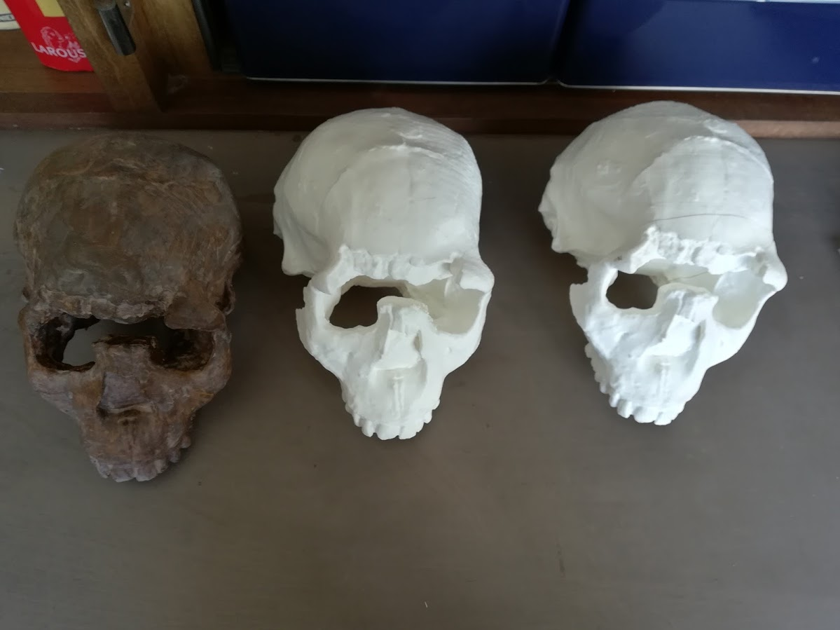
WP4 Non contract reproduction of cultural heritage objects
  Task 4.1 Evaluation of the virtual reproduction of physical objects (RBINS, 1-12mths)
  Currently evaluating 3D printing of skulls –Turkana boy
Notes:
This project aims to utilise the existing digital collection of Neandertal and AMH fossils which are housed at the Royal Belgian Institute of Natural Sciences and to showcase the reconstructed Spy skeleton to highlight Belgian scientific and cultural heritage as well the current state of the art research in Belgium. There are four aspects to the project:
1) improvement of existing 'lhpFusionBox' software to make this programme fully adapted to the needs of paleoanthropologists,
2)the creation of a serious game using the reconstructed Spy II skeleton and body,
3)to prepare the reconstructed 3D Spy II Neandertal and other Neandertal fossil specimens for 3D printing and then place these fossils online and freely available
4) to create an interactive website which will serve as an educational experience on Neandertals, who are often portrayed in the public as cavemen, stupid brutish and more ape like than modern humans.
12

Slide 13
WP5 Creation of multilingual website based on Neandertals
The aim of this WP is to create an International website based on Neandertals. The website will be created by ADIA in conjunction with RBINS and the new state of the art research in Neandertals being performed at VUB and ULB will be incorporated into the website
  Task 5.1 Content of the website (ADIA, 1-6mths)
  Task 5.2 Scenario (ADIA, 1-6mths)
  Task 5.3 Text writing and collection of documents (ADIA, 1-6mths)
  Task 5.4 Creation and design of the website (ADIA, 6-24mths)
  Task 5.5 Upload and integration of the 3D models and animation on Sketchfab platform (ADIA, 6-12mths)
  Task 5.6 Testing of the rendering and interactions (ADIA, 18-24mths)
  Task 5.7 Translation in Dutch and English (ADIA, 18-24mths)
Notes:
This project aims to utilise the existing digital collection of Neandertal and AMH fossils which are housed at the Royal Belgian Institute of Natural Sciences and to showcase the reconstructed Spy skeleton to highlight Belgian scientific and cultural heritage as well the current state of the art research in Belgium. There are four aspects to the project:
1) improvement of existing 'lhpFusionBox' software to make this programme fully adapted to the needs of paleoanthropologists,
2)the creation of a serious game using the reconstructed Spy II skeleton and body,
3)to prepare the reconstructed 3D Spy II Neandertal and other Neandertal fossil specimens for 3D printing and then place these fossils online and freely available
4) to create an interactive website which will serve as an educational experience on Neandertals, who are often portrayed in the public as cavemen, stupid brutish and more ape like than modern humans.
13

Slide 14
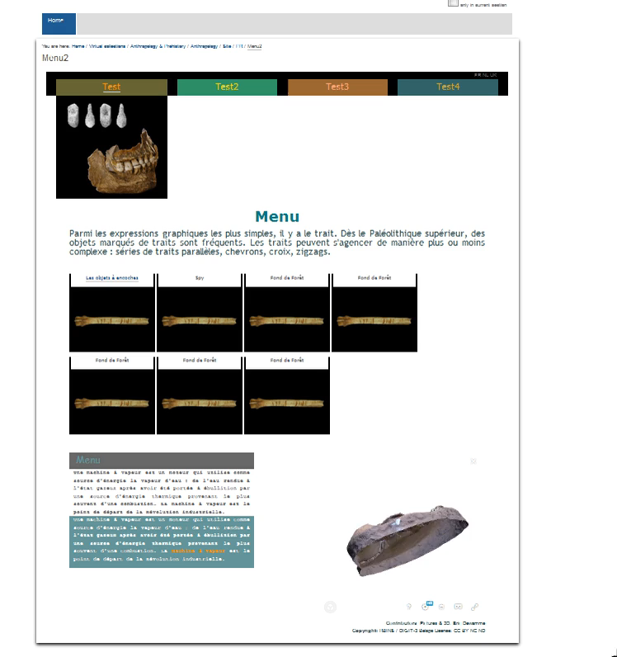
WP5 : Create interactive website
Notes:
This project aims to utilise the existing digital collection of Neandertal and AMH fossils which are housed at the Royal Belgian Institute of Natural Sciences and to showcase the reconstructed Spy skeleton to highlight Belgian scientific and cultural heritage as well the current state of the art research in Belgium. There are four aspects to the project:
1) improvement of existing 'lhpFusionBox' software to make this programme fully adapted to the needs of paleoanthropologists,
2)the creation of a serious game using the reconstructed Spy II skeleton and body,
3)to prepare the reconstructed 3D Spy II Neandertal and other Neandertal fossil specimens for 3D printing and then place these fossils online and freely available
4) to create an interactive website which will serve as an educational experience on Neandertals, who are often portrayed in the public as cavemen, stupid brutish and more ape like than modern humans.
14

Slide 15
WP6 Creation of a Neandertal Avatar based game
The aim of this WP is to create a Neandertal Avatar based on the Spy II skeleton and to use that avatar in computer games for both educational purposes for school children taking part in the animations by ADIA and for use in serious gaming. The avatar will also be used in the project website.
  Task 6.1. Preparation of the reconstructed skeleton (VUB, 6-12mths)
  Task 6.2. Identification of gaming scenarios for specific age groups for educational purposes (ADIA, 12-18mths)
  Task 6.3 Analysis which existing serious games to use for the developed Neandertal avatar (RBINS, 12-18mths)
  Task 6.4 Development of tablet games (VUB, 18-24mths)
  Task 6.5 Incorporation of the 3D models into rehabilitation games (VUB, 18-24mths)
  Task 6.6 Game evaluation (ADIA, 18-24mths)
Notes:
This project aims to utilise the existing digital collection of Neandertal and AMH fossils which are housed at the Royal Belgian Institute of Natural Sciences and to showcase the reconstructed Spy skeleton to highlight Belgian scientific and cultural heritage as well the current state of the art research in Belgium. There are four aspects to the project:
1) improvement of existing 'lhpFusionBox' software to make this programme fully adapted to the needs of paleoanthropologists,
2)the creation of a serious game using the reconstructed Spy II skeleton and body,
3)to prepare the reconstructed 3D Spy II Neandertal and other Neandertal fossil specimens for 3D printing and then place these fossils online and freely available
4) to create an interactive website which will serve as an educational experience on Neandertals, who are often portrayed in the public as cavemen, stupid brutish and more ape like than modern humans.
15

Slide 16
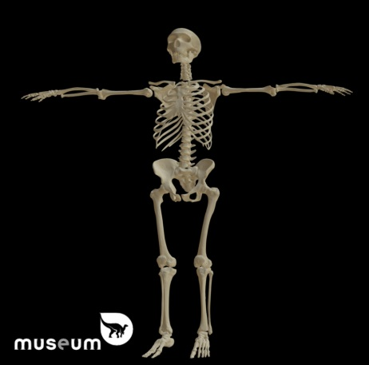
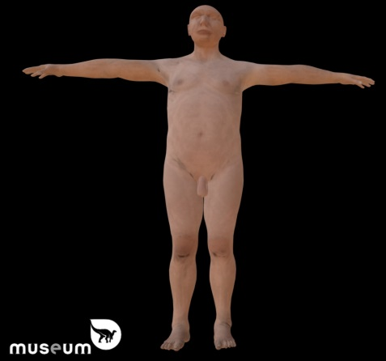
WP6 .Task 6.1
Creation of an avatar
Pre-existing avatar in RBINS
To clothe or not to clothe?
Ideas for the avatar:
Superman costume (although S for Spyrou..)?
Loincloth?
Naked?
Skeleton only ?
Spy II 3D model
Model of Spy II avatar in raw format (printed in wood and displayed in RBINS
Notes:
This project aims to utilise the existing digital collection of Neandertal and AMH fossils which are housed at the Royal Belgian Institute of Natural Sciences and to showcase the reconstructed Spy skeleton to highlight Belgian scientific and cultural heritage as well the current state of the art research in Belgium. There are four aspects to the project:
1) improvement of existing 'lhpFusionBox' software to make this programme fully adapted to the needs of paleoanthropologists,
2)the creation of a serious game using the reconstructed Spy II skeleton and body,
3)to prepare the reconstructed 3D Spy II Neandertal and other Neandertal fossil specimens for 3D printing and then place these fossils online and freely available
4) to create an interactive website which will serve as an educational experience on Neandertals, who are often portrayed in the public as cavemen, stupid brutish and more ape like than modern humans.
16

Slide 17
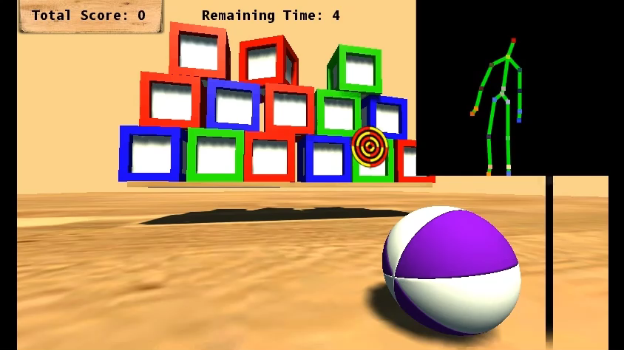
WP6
  Rocks thrown at mini mammoths
Notes:
This project aims to utilise the existing digital collection of Neandertal and AMH fossils which are housed at the Royal Belgian Institute of Natural Sciences and to showcase the reconstructed Spy skeleton to highlight Belgian scientific and cultural heritage as well the current state of the art research in Belgium. There are four aspects to the project:
1) improvement of existing 'lhpFusionBox' software to make this programme fully adapted to the needs of paleoanthropologists,
2)the creation of a serious game using the reconstructed Spy II skeleton and body,
3)to prepare the reconstructed 3D Spy II Neandertal and other Neandertal fossil specimens for 3D printing and then place these fossils online and freely available
4) to create an interactive website which will serve as an educational experience on Neandertals, who are often portrayed in the public as cavemen, stupid brutish and more ape like than modern humans.
17

Slide 18
WP7 Dissemination and vulgarisation
Dissemination of the new tools developed in lhpFusionBox to palaeoanthropologists as well as anatomists, medical students and students working on comparative morphology studies, measurements, musculoskeletal models and biomechanics.
  Task 7.1 Dissemination to University students and scholars (RBINS, 12-24mths).
  Task 7.2 Dissemination to schools and museums on virtual casting (RBINS12-24mths).
  Task 7.3 Dissemination to electronic visitors (RBINS, 18-24mths)
  Task 7.4 Dissemination to medical patients (ULB, 18-24mths)
  Task 7.5 Dissemination via Sketchfab and the creation of a Blog (RBINS, 18-24mths)
Notes:
This project aims to utilise the existing digital collection of Neandertal and AMH fossils which are housed at the Royal Belgian Institute of Natural Sciences and to showcase the reconstructed Spy skeleton to highlight Belgian scientific and cultural heritage as well the current state of the art research in Belgium. There are four aspects to the project:
1) improvement of existing 'lhpFusionBox' software to make this programme fully adapted to the needs of paleoanthropologists,
2)the creation of a serious game using the reconstructed Spy II skeleton and body,
3)to prepare the reconstructed 3D Spy II Neandertal and other Neandertal fossil specimens for 3D printing and then place these fossils online and freely available
4) to create an interactive website which will serve as an educational experience on Neandertals, who are often portrayed in the public as cavemen, stupid brutish and more ape like than modern humans.
18

Slide 19
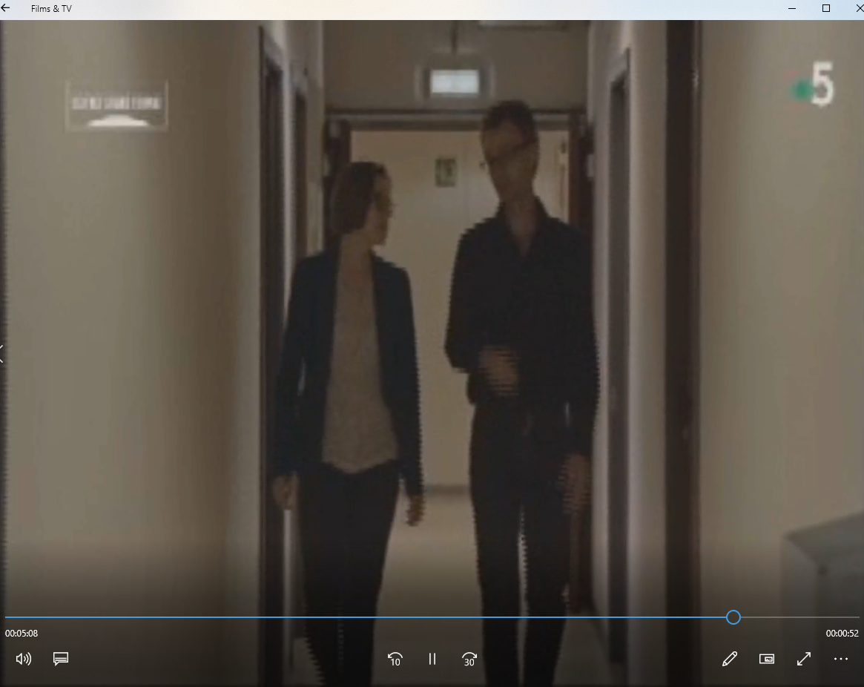
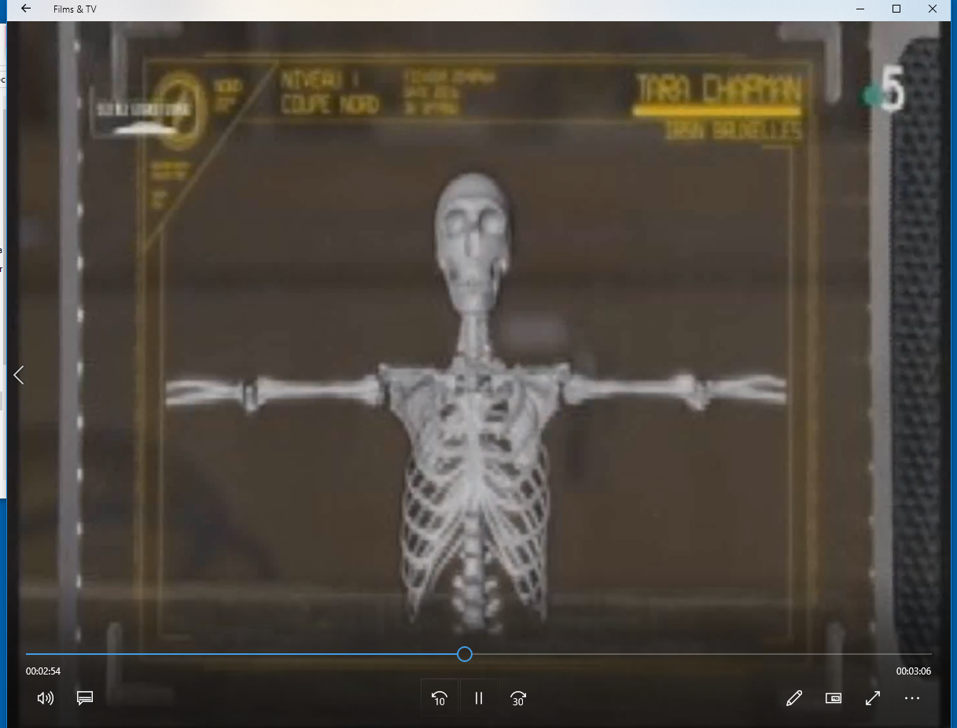
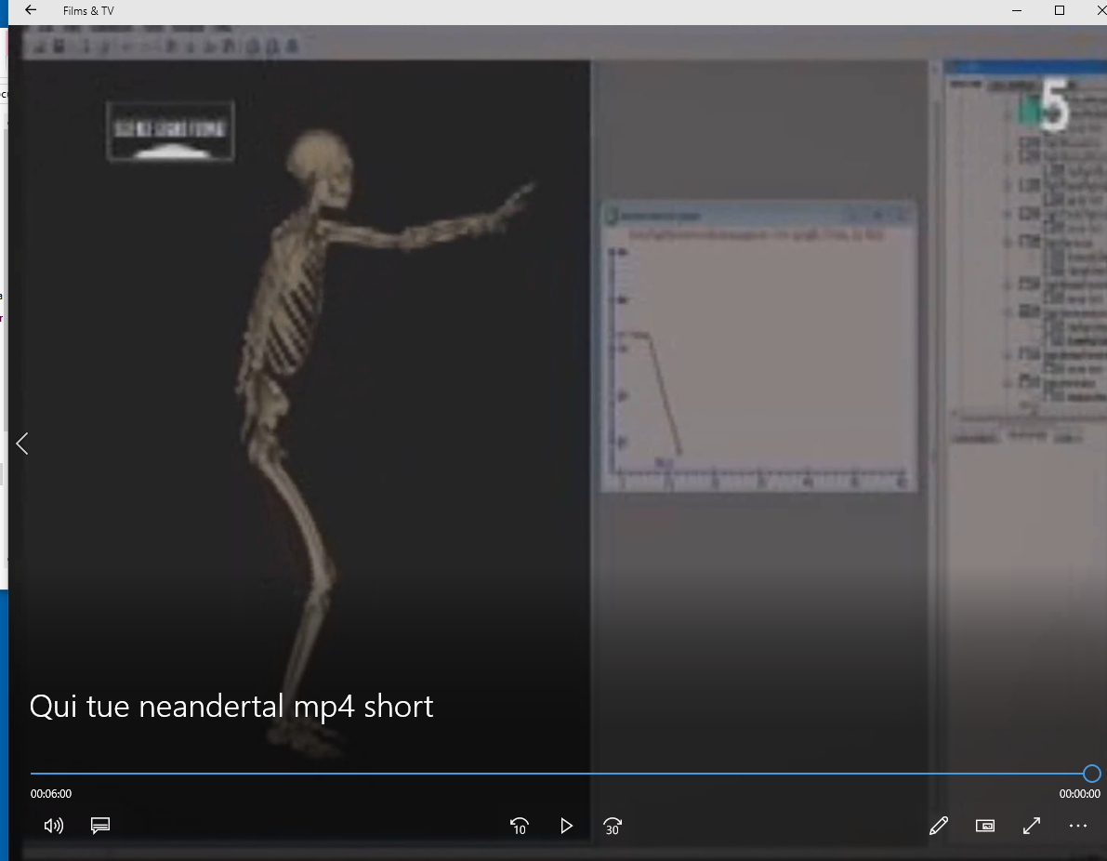
Dissemination – Spy reconstructed skeleton
‘Qui a tué Neandertal (broadcast in April 2018 on France 5)
Notes:
Investigate new techniques for motion analysis – i.e. using joint surface as constraints to guide the motion. A surface scan of the bones will be conducted and analysed with the data from the CT scans

